Slide 1
HIRING PROCESS ANALYTICS
Project-4
By Ritu Srivastava

Slide 2
ABOUT PROJECT
Hiring process is the fundamental and the most important function of a company. Here, the MNCs get to know about the major underlying trends about the hiring process. Trends such as- number of rejections, number of interviews, types of jobs, vacancies etc. are important for a company to analyse before hiring freshers or any other individual.
Thus it create an immense opportunity to learn for the data analyst and explore the new dataset explicitly
In this project, we are provided with the data records of their previous hirings and have asked us to answer certain questions making sense out of that data.
Dataset of a company contains details about people who registered for a particular post in a department of the company. We are required to use our knowledge of statistics and excel formulas to draw necessary conclusions about the company.

Slide 3
APPROACH AND TECH STACK
Exploratory Data Analysis (EDA) can be used to do this, it is an approach to analyze the data using visual techniques. The following steps are involved –
• Understanding data columns and data
• Checking for missing data
• Clubbing columns with multiple categories
• Checking for outliers
• Removing outliers
• Drawing Data Summary
In order to accomplish project the first thing required is to understand the different column given in excel and their correlation with each other, based on question type asked different concept like COUNT (), SUM (), AVERAGE (), PIVOT TABLE, SLICER can be used to answer the question.
Tech stack- Google sheets and MS Excel or else Tableau for dashboarding

Slide 4
a) Hiring: How many males and females are Hired?
OUTPUT Gender Number of Applicant (Hired)
Female =1856 and Male =2563
b) Average Salary: What is the average salary offered in this company?
OUTPUT Average Salary Offered
49983.02 (Salary offered in this company is salary offered to both status applicant i.e., who are hired and rejected. )

Slide 5
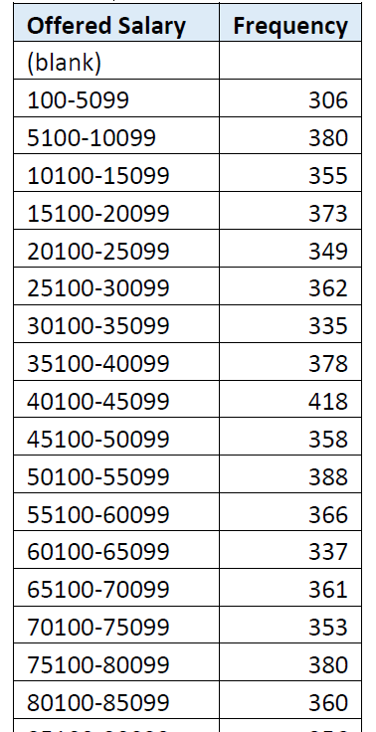
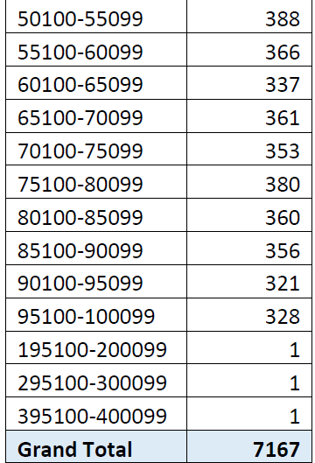
Approach
c) Class Intervals: Draw the class intervals for salary in the company?
OUTPUT- Class Interval here is 4999

Slide 6
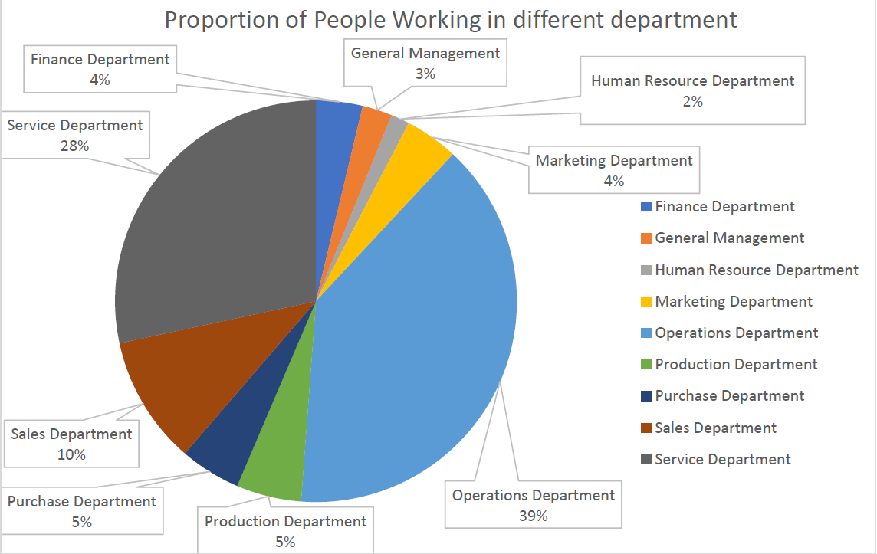
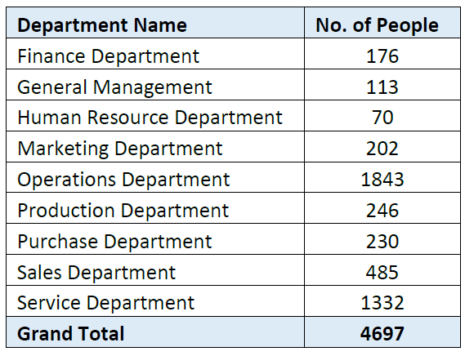
Approach
d) Charts and Plots: Draw Pie Chart/Bar Graph (or any other graph) to show proportion of people working different department?
NOTE-Only for hired candidates

Slide 7
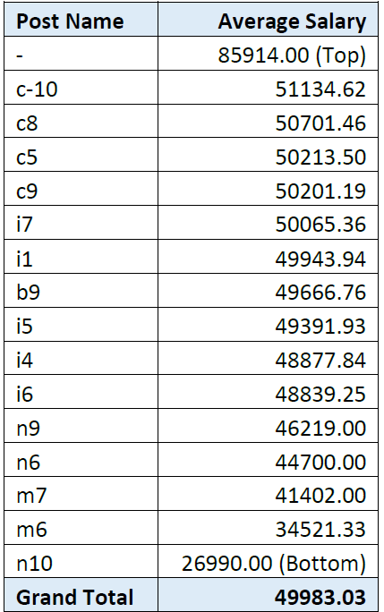
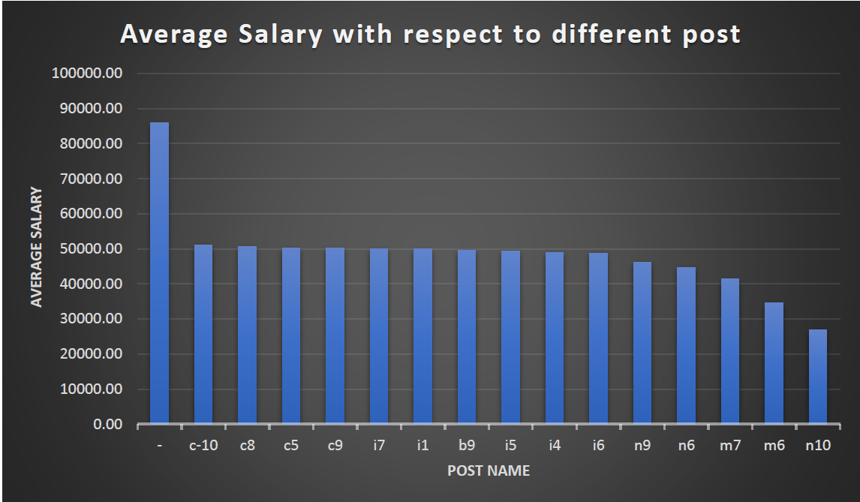
Approach
Charts: Represent different post tiers using chart/graph?
NOTE- To the post having higher average salary will be top in hierarchical level and lowest will be in bottom

Slide 8
Insights and Results
The rejection rate of male applicant is 6% higher than female.
Female are paid 0.42% more than male in this company
Most of the company’s money spent by Operations Department
Most of the post (around 7) are vacant in HR department, so company might hire for different post.
The number of people in operation department is more than any other department.
Most paid post under sales Department is –
Most of the posts in Finance department, Marketing Department, Service Department and General department are dominated by females.
The number of applicants is higher in month of July, may be because college student start graduating in that month and also company hire most of applicant in this month.

Slide 9
Results
This project makes us to understand how to summarize huge data and get insight from that. Pivot table, Slicer, Graph/Chart and Conditional formatting makes the task very easy.
• The dependency of one data on other can be easily checked by Pivot table and Slicer.
Use of actual excel sheet and formula shortcuts to provide insight when we don’t have to use other resources access like tableau
This project is optimised and perfect blend of understanding of advance use of Ms Excel .

